Slide 1
Tips for Managing Big Behaviors During a Pandemic
Julia Sayles, LMHC
juliaksayles@gmail.com

Slide 2
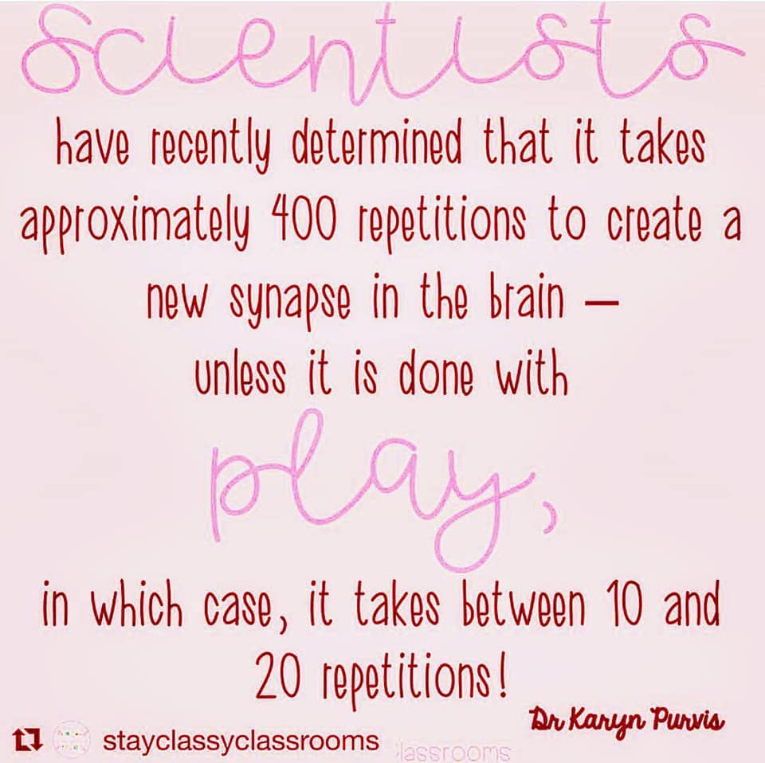

Slide 3
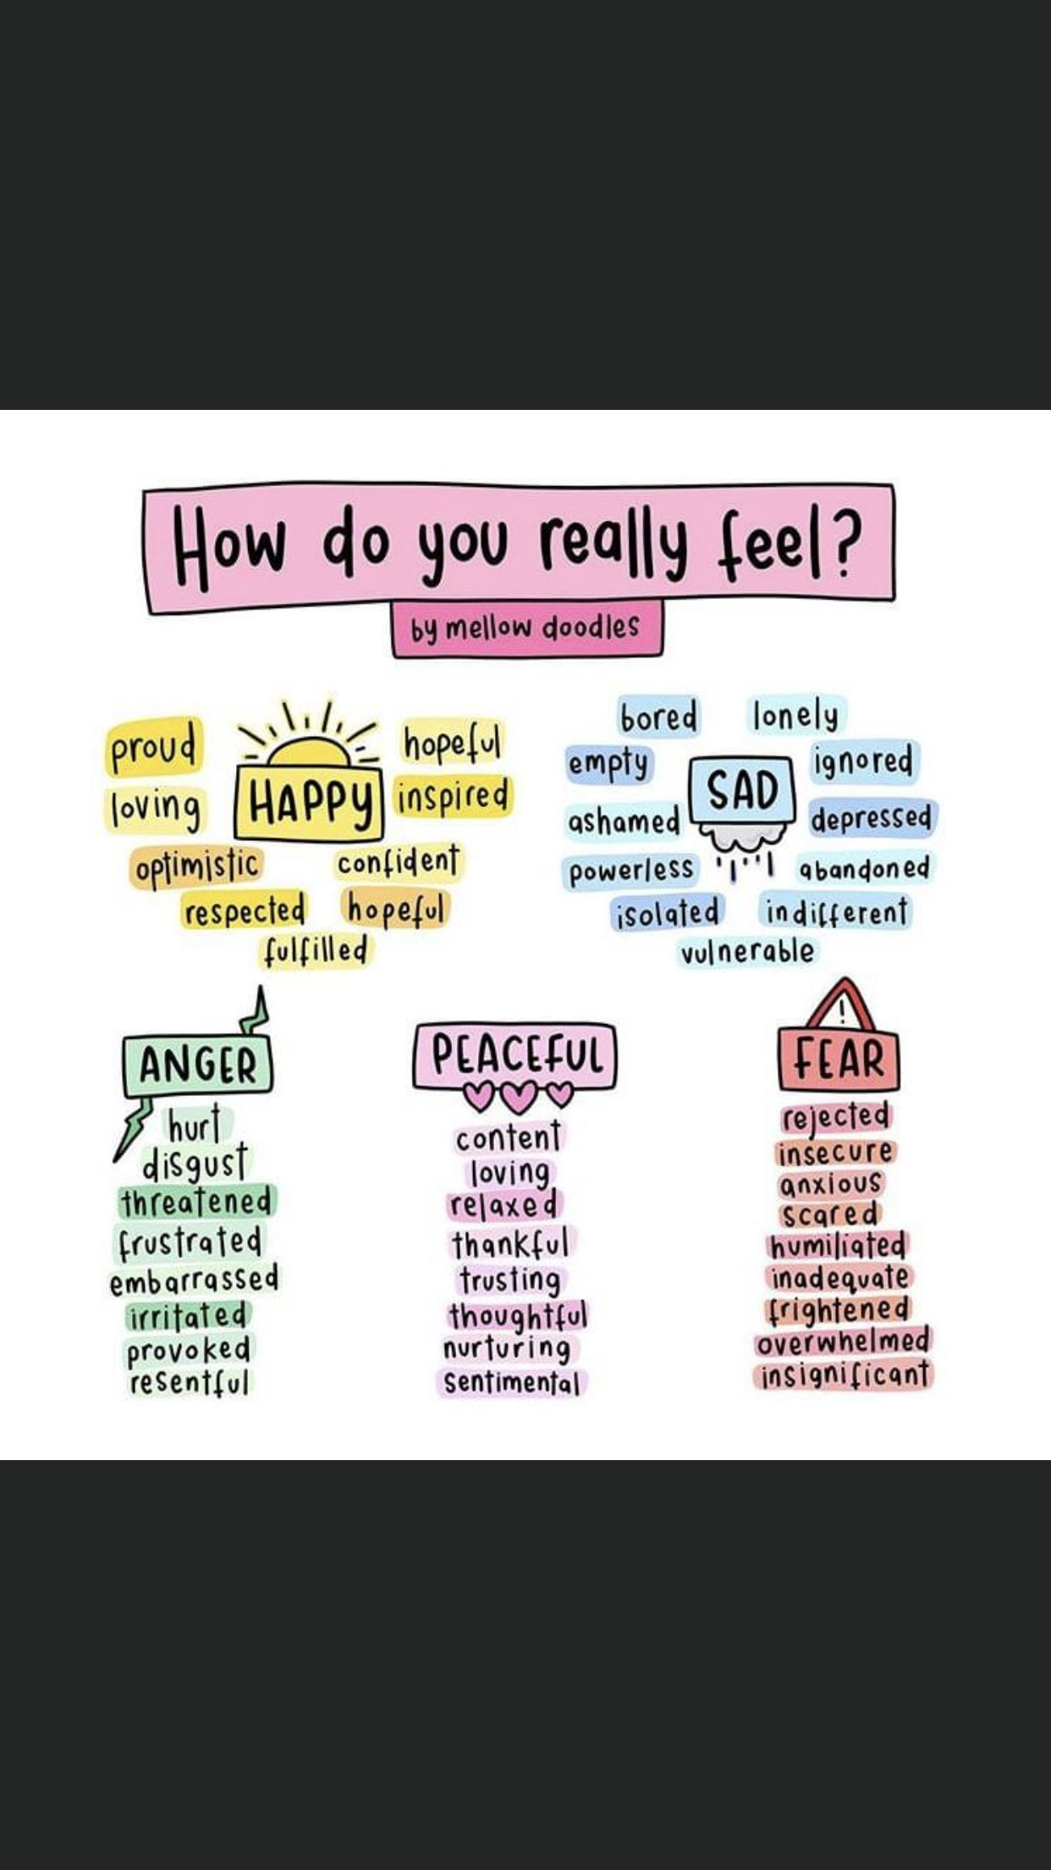

Slide 4
Expectations
Expectations: general ways you want people to act in your family.
Example Expectations:
Be Respectful
Be a Helper
Be Safe
Be a Team Player
Be Peaceful
Be Polite
Be Responsible
Be Honest
Be Friendly
Be Kind
Linking Family Expectations to Family Rules
The expectation serves as the “Why”
The rule helps to stay consistent with setting the limit
Can reduce the power struggle when laid out clearly

Slide 5
Reinforcing Family Expectations
I used a honey voice
I shared
I listened to directions

Slide 6
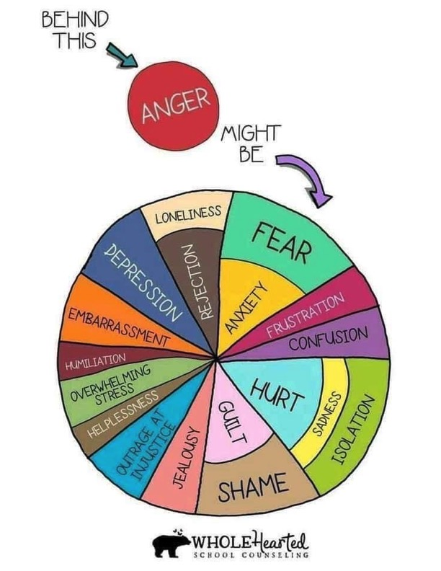

Slide 7
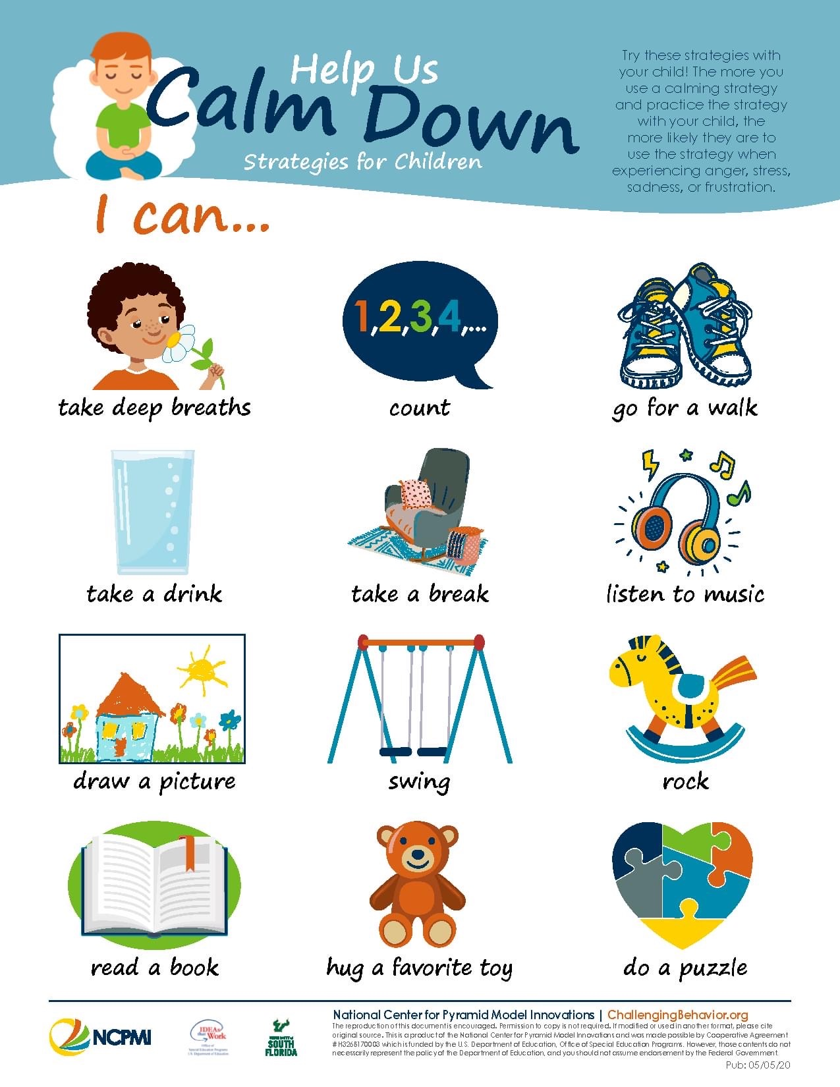

Slide 8
Tuck
https://challengingbehavior.cbcs.usf.edu/docs/TuckerTurtle_Story_Home.pdf

Slide 10
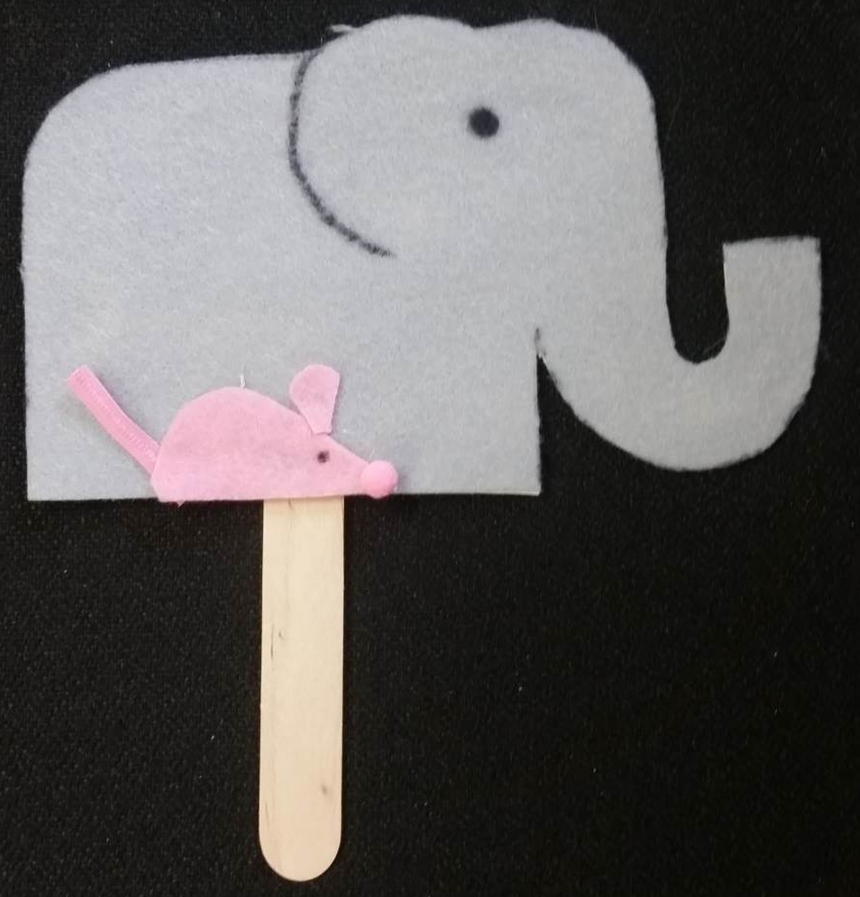
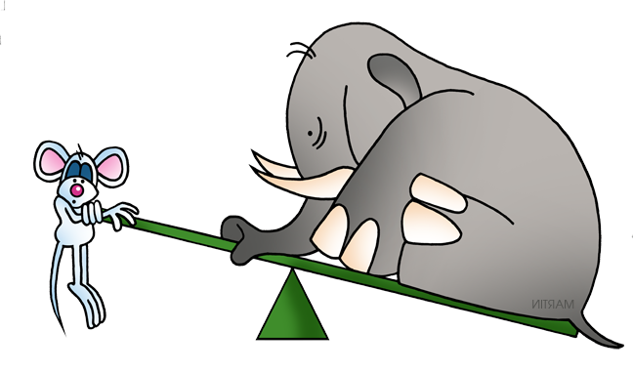
How Big is Your Problem?
Elephant or Mouse?
Help children identify if their problem is:
  “Mouse” size and could be solved without adult help
  OR
  “Elephant” size and adult help is needed
Notes:
Taking a toy
Physical aggression
not know what center to go to
Cuts in line
Can’t find something
Wants to be first
Hears a mean word

Slide 11
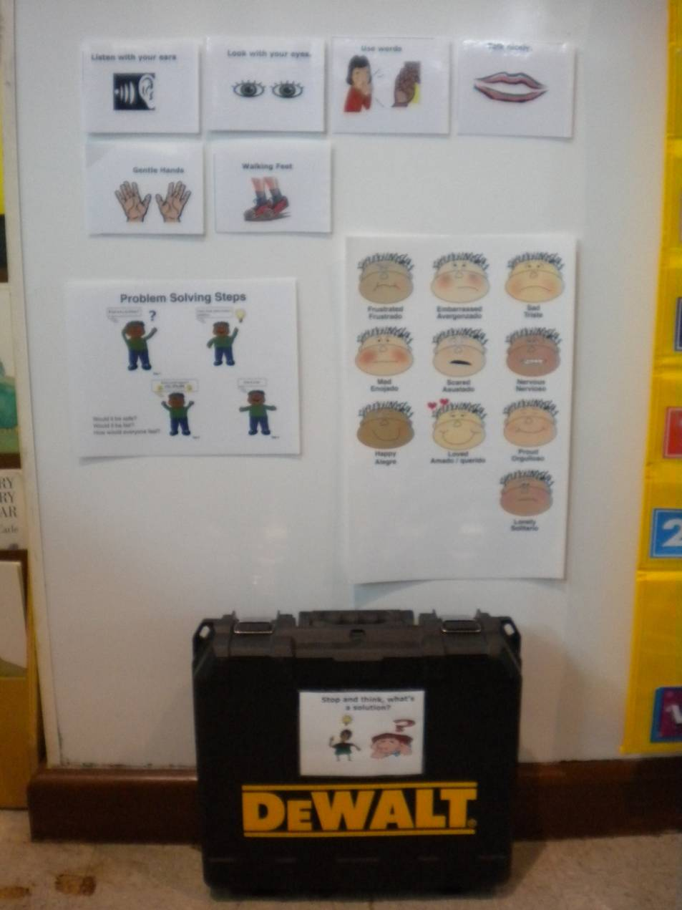
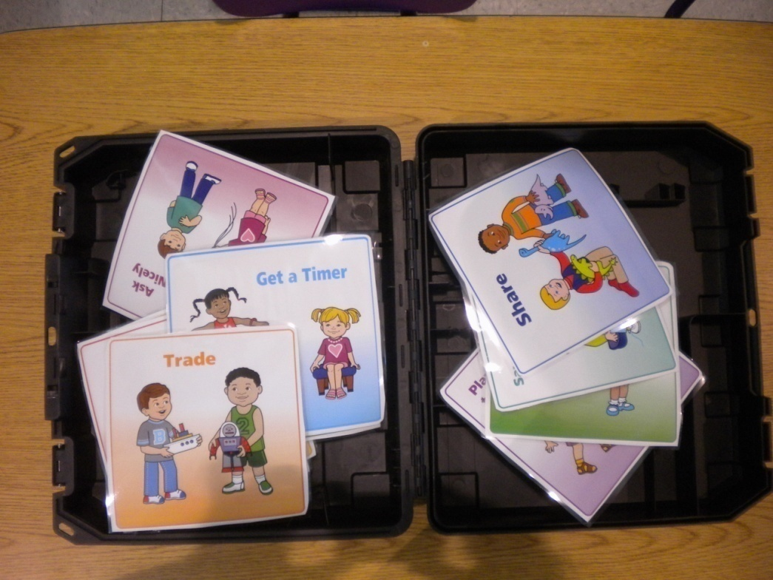
Sample Solution Kit

Slide 12

Setting Limits

Slide 13
Strategies
Patterns and Problems
Leaning In and Leaning Out
Mixing limit setting strategies
ACT

Slide 14
Limit Setting
Preview Preview Preview
  Behavior expectations and rules should be reviewed and intentionally taught across the day
  Natural consequences should be tied to rules/expectations
  Tone of voice should be firm but calm
  Be consistent with warning etc.
  Watch out for “funky patterning”
  10 words or less 10 seconds or less
  Think about after the limit is set how you will “repair” with the child

Slide 15
Setting Limits
Acknowledge, Validate & Match Intensity
“You are so angry right now.”
Communicate the limit (brief, clear, neutral tone).
“And we keep our body safe.”
Target an acceptable alternative that meets the function of the behavior.
“You can hit a pillow instead of your brother or you can use your loud voice in your room.”

